Slide 1

LangGraph
By

Slide 2
LangChain Vs LangGraph
Problem with traditional LangChain agents
LangChain agents are:
Easy to use
Fast to prototype
Great for demos
But they are hard to control:
You cannot see or modify the internal loop
No explicit state transitions
Hard to add retries, fallbacks, or approvals
Difficult to debug long-running agents
LangGraph solves this
LangGraph introduces:
Explicit control flow
State machines for agents
Deterministic execution
Production reliability
Key idea: LangGraph turns agents into graphs.
Conceptual Shift: Chain → Graph
LangChain mental model
Prompt → LLM → Tool → LLM → Output
Implicit loop
Hidden logic
LangGraph mental model
Node → Edge → Node → Conditional Edge → Node
Explicit execution
You define every transition

Slide 3
Building Blocks of LangGraph
Nodes
Nodes are individual functions or operation that perform specific tasks within the graph. Each node receives input(current state) ,process it and produces and output or and updated state.
Edges:
Edges are the connections between nodes that determines the flow of execution. Tell which node should be executed next after the current one completes its task.
StateGraph:
Is a class in LangGraph used to build and compile the graph structure. It manages the nodes, edges and the overall the state, ensuring that the workflow operated in a unified way and that data flows correctly between components.
State:
It is a shared data structure that holds the current information or context of the entire application.
Conditional Edges (Decision Making)
This is where agents become intelligent.
Persistence & Checkpointing
Streaming
Human-in-the-loop
Time Travel

Slide 4
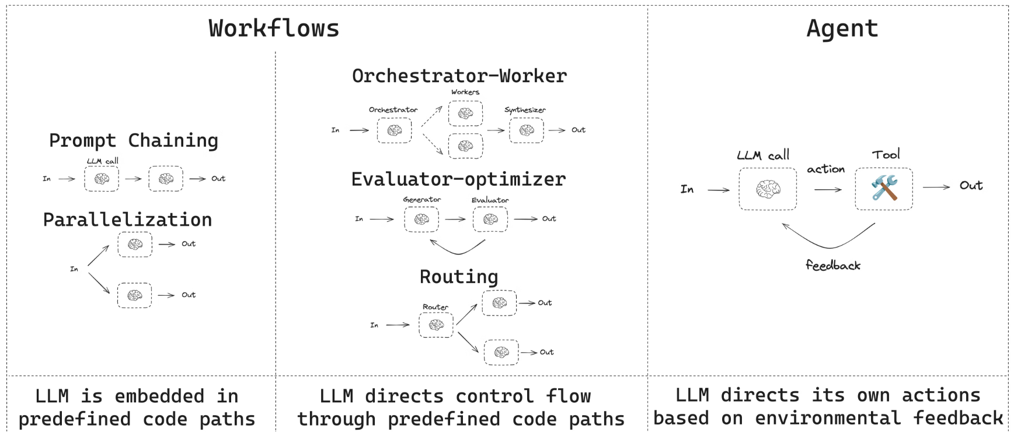
Workflows

Slide 5
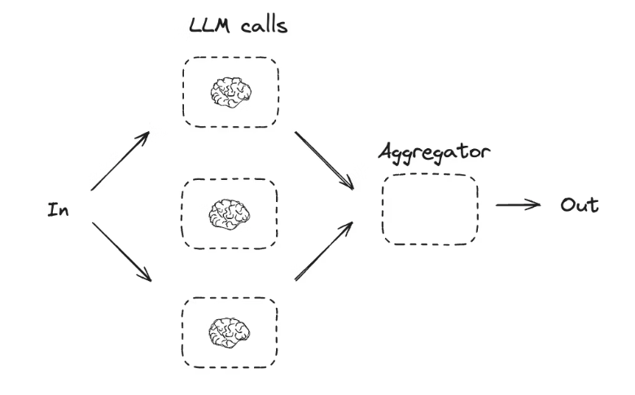
Parallelization
Parallelization Parallelization means running multiple LLM tasks at the same time instead of sequentially.
Why use it?
Faster execution by splitting work into independent subtasks
Higher confidence by running the same task multiple times and comparing results
How it’s used:
Subtask parallelism: Run different tasks simultaneously Example: One LLM extracts keywords while another checks formatting errors.
Redundant parallelism: Run the same task multiple times with different criteria Example: Score a document in parallel for citation count, source quality, and factual accuracy.
In one line: Parallelization improves speed and reliability by letting LLMs work concurrently.

Slide 6
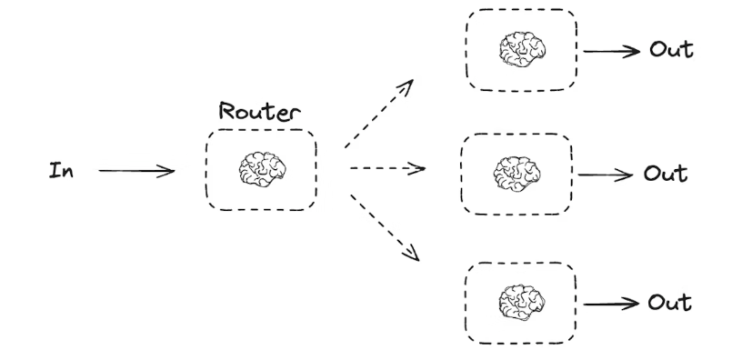
Routing
Routing analyzes an input first and then directs it to the most appropriate task or flow.
Why use it?
Handles complex, multi-intent requests
Enables specialized logic for each category
Example: A product-support workflow routes queries to different paths:
Pricing → pricing handler
Refunds → refund policy flow
Returns → return processing flow
In one line: Routing sends the right input to the right workflow based on intent.

Slide 7
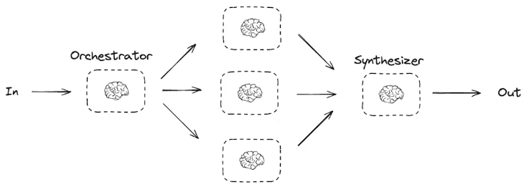
Orchestrator- Worker
Orchestrator–Worker (LLM workflows) In this pattern, one LLM (the orchestrator) manages the work, while multiple workers execute subtasks.
What the orchestrator does:
Breaks a complex task into subtasks
Assigns each subtask to a worker
Combines worker outputs into a final result
Why use it?
Works well when subtasks are not known in advance
Handles dynamic, multi-step problems better than simple parallelization
Example: Updating installation instructions across many Python libraries:
Orchestrator identifies which files/libraries need changes
Workers update each file independently
Orchestrator reviews and merges all updates
In one line: The orchestrator plans and coordinates, workers execute, and the orchestrator synthesizes the final output.

Slide 8
Orchestrator - Send API
LangGraph natively supports orchestrator–worker workflows using the Send API.
How it works:
The orchestrator dynamically decides what work needs to be done
Send() creates worker nodes at runtime and passes each worker its own input
Each worker runs with its own state
Worker outputs are written to a shared state key
The orchestrator accesses all worker outputs and synthesizes the final result
Example idea: Iterate over a list of sections and use Send() to dispatch each section to a worker, then merge all completed sections into one output.
In one line: The Send API enables dynamic task creation, parallel workers, and centralized synthesis in orchestrator–worker workflows.

Slide 9
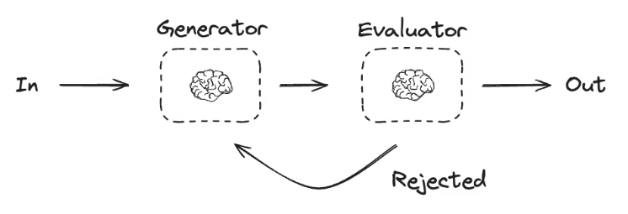
Generator - Evaluator
Evaluator–optimizer workflow: One LLM generates a response, another evaluates it against defined criteria. If it falls short, feedback is given and the response is regenerated. This loop repeats until the output is acceptable.
When to use: Ideal for tasks with clear success criteria that require iteration—such as refining translations, improving content quality, or meeting style and accuracy standards.

Slide 10
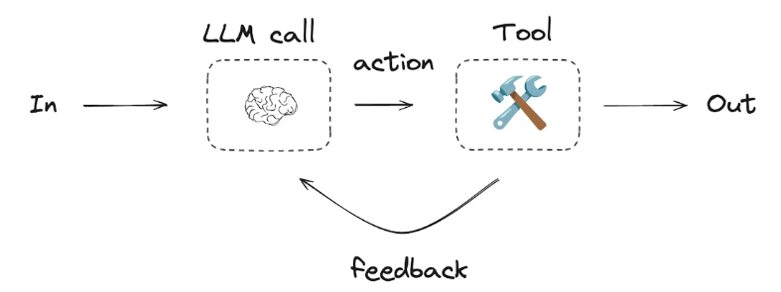
Agents
Agents: Agents are LLMs that autonomously use tools in feedback loops to solve unpredictable problems.
They decide which tools to use and how to act, while operating within developer-defined tools and behavior guidelines.

Slide 11
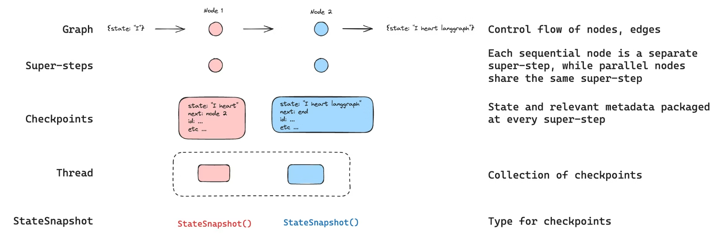
Persistence
LangGraph has a built-in persistence layer, implemented through checkpointers.
When you compile a graph with a checkpointer, it saves a checkpoint of the graph state at every super-step. Those checkpoints are saved to a thread, which can be accessed after graph execution.
human-in-the-loop, memory, time travel, and fault-tolerance are all possible through threads.

Slide 12
Reducers
Reducers define how state updates are merged when:
Multiple nodes write to the same state key
Parallel branches (fan-out) return results
A node is executed multiple times
Shared state keys like messages, logs, steps, tool_results
Without reducers, later writes would overwrite earlier ones.
Reducer Type | Typical Use
add | Accumulate lists, strings, numbers(sum)
Deduplicate | Fan-in workers
Max / Min | Best result
Dict merge | Metadata enrichment
Boolean OR | Completion / flags
from typing import Annotated, TypedDict
import operator
class State(TypedDict):
messages: Annotated[list[str], operator.add]
We use “Annotated” and use add to enable reducer, Every node that writes to messages will append instead of overwrite.
Reducers control how LangGraph merges state updates instead of blindly overwriting them.

Slide 13
Stream
LangGraph implements a streaming system to surface real-time updates.
Mode | Description
values | Streams the full value of the state after each step of the graph.
updates | Streams the updates to the state after each step of the graph. If multiple updates are made in the same step (e.g., multiple nodes are run), those updates are streamed separately.
for chunk in graph.stream(
{"topic": "ice cream"},
stream_mode="values",
):
print(chunk)
for chunk in graph.stream(
{"topic": "ice cream"},
stream_mode=“Updates",
):
print(chunk)
Shows only the final output values of the nodes.
Shows node lifecycle (running → completed).
'Ice cream is a frozen dessert made from cream and sugar.'
'Popular flavors include vanilla, chocolate, and strawberry.'
{'node_id': 'generate_summary', 'status': 'running', 'value': None, 'timestamp': 123456789}
{'node_id': 'generate_summary', 'status': 'completed', 'value': 'Ice cream is a frozen dessert made from cream and sugar.', 'timestamp': 123456790}
{'node_id': 'generate_flavors', 'status': 'running', 'value': None, 'timestamp': 123456791}
{'node_id': 'generate_flavors', 'status': 'completed', 'value': 'Popular flavors include vanilla, chocolate, and strawberry.', 'timestamp': 123456792}

Slide 14
Thank you

